Slide 1
The Junior Prize is open to all students in the Aldridge family of schools.
Students are welcome to submit work that they have created in their own time.
There are 5 categories: FINE ART | GRAPHICS | TEXTILES | PHOTOGRAPHY | FILM

Slide 2
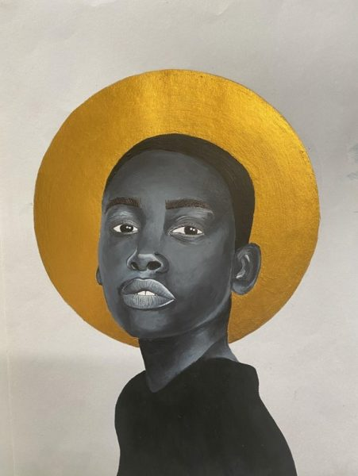
How will my art be judged?
Quality of artistic composition
Creativity and originality
Success of description and/or title
Overall impression of the artwork
Who will be judging it?
Entries will be judged by a panel of esteemed industry professionals and representatives of the Aldridge Foundation and Callsign.
What do I win?
If you are a finalist your work will be exhibited alongside a professional exhibition of artists work at the Bankside Hotel, London.
The overall winner of the Junior Prize will be offered an internship with DegreeArt.

Slide 3
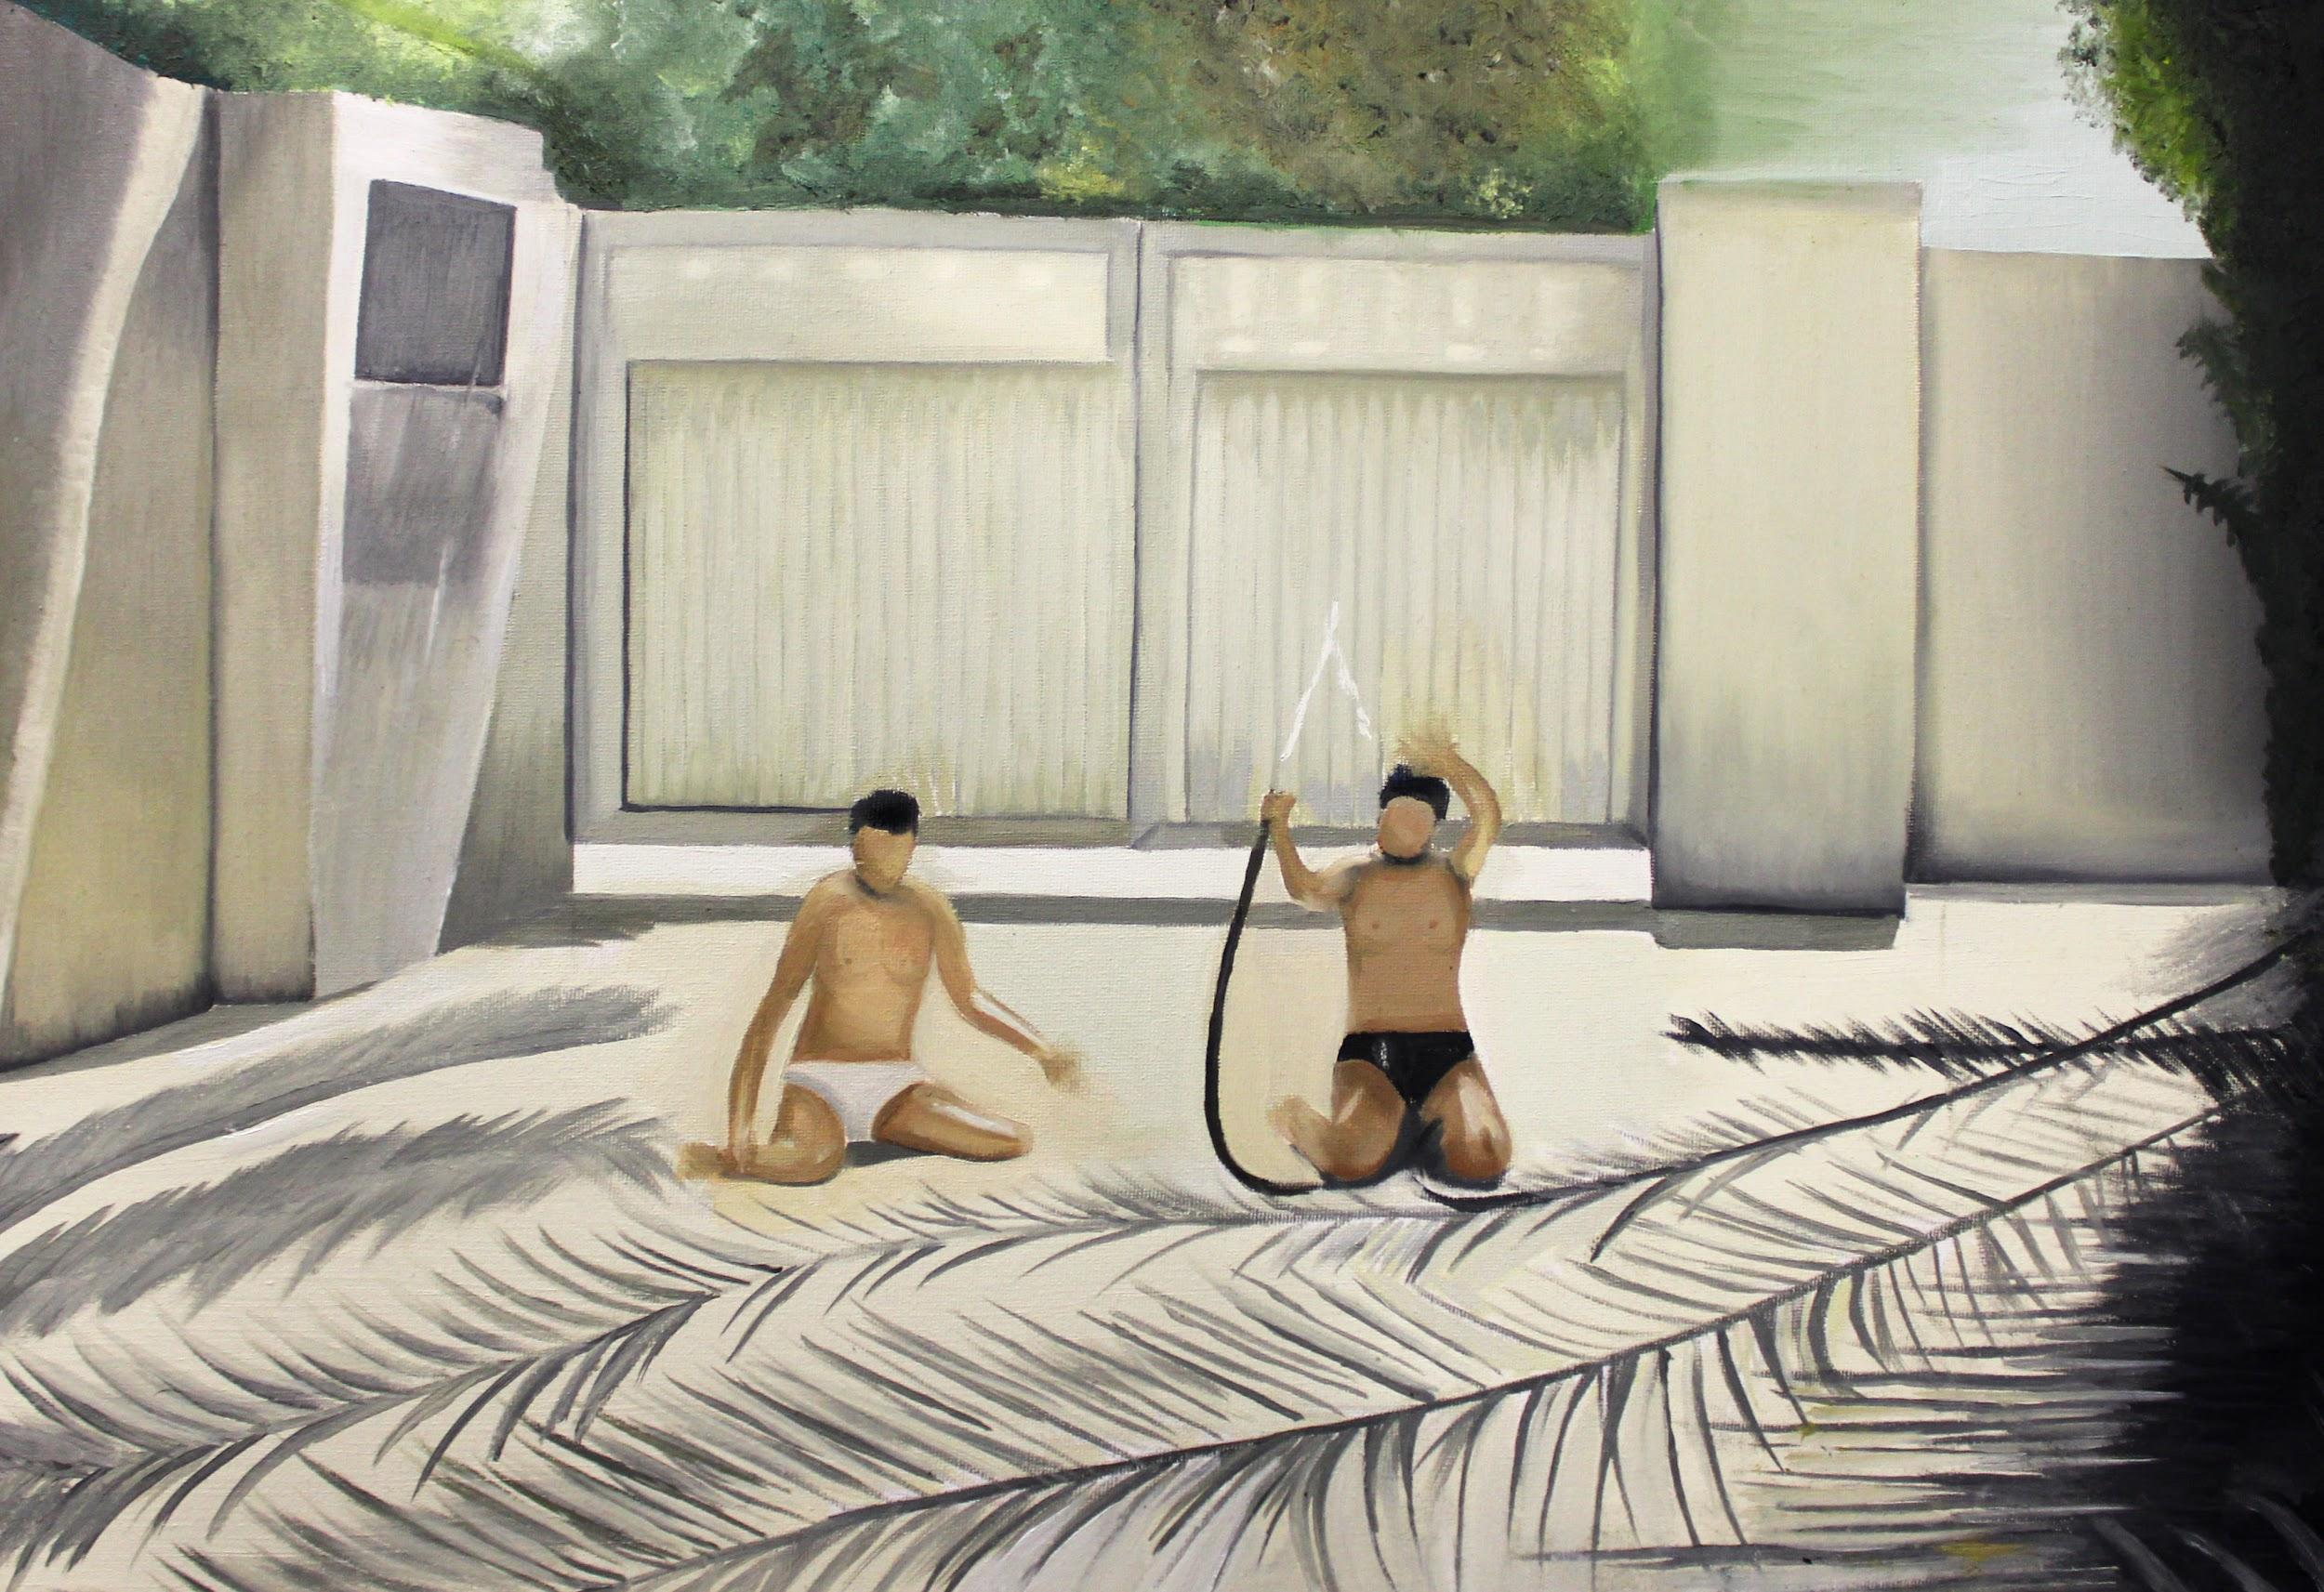
Manar painting, and the Fine Art Winner
2021/2
Hanna’s painting “Lizu Mahu’ Overall Winner 2020/21

Slide 4
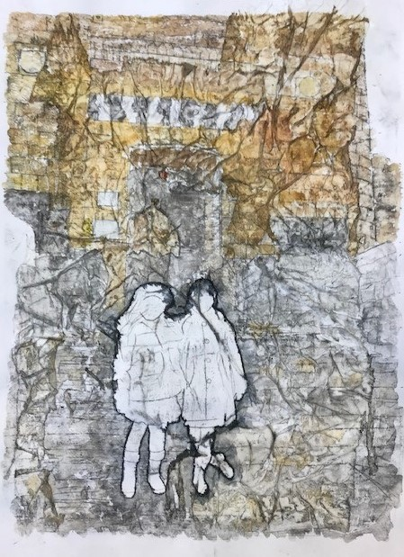
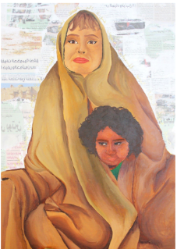
Please note: students are permitted to enter artwork into multiple categories but cannot enter more than one piece of artwork in the same category.
Due to OFQUAL regulations, current artwork being submitted for examinations cannot be entered – if you are unsure whether this applies to you, please check with your art teacher.
The judges will announce their chosen finalists - three artists per category – in early 2023.
Deadline: Friday 6th January 2023.
Zeina
Fine Art Finalist
2021/2
Layla
Fine Art Finalist
2021/2
Manar Fine Art Winner
2021/2

